Slide 1
CS3907-80/CS6444-10: Big Data and Analytics
Summer 2021
Stephen H. Kaisler, D.Sc.
Lecture 9 – Issues and Challenges
Notes:
There are a lot of issues and challenges for Big Data.
Although Big Data has been around for over two decades in the scientific community, it is now prevalent in every discipline with the Web storing and generating petabytes of data per day, with personal devices generating so much data, and with the various social media generating and regenerating data.
In this lecture we will look at a some of the critical issues and challenges that affect Big Data, and laterally, Data Science.

Slide 2
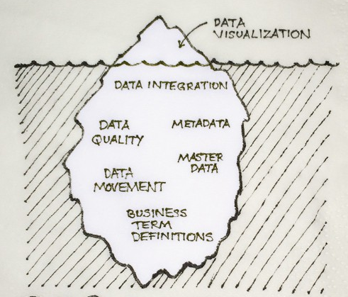
Issues and Challenges
Big Data: Issues and Challenges
Analytics: Issues and Challenges
Wicked Problems
Black Swan* Problems (Not the Movie!!)
CSCI3907/CSCI6444 - Big Data and Analytics
13-<number>
Notes:
As the image shows, we usually are only aware of a small amount of the available data.
There are many data bases available with large quantities of data that can be used to examine different scientific, engineering, social, health and other problems.
We only briefly talked about data cleansing, which is a very important aspect of data preparation before we can begin to do analysis.
Many estimates say that 80% of the work in data science is data preparation, with 20% devoted to analysis, interpretation, and reporting.

Slide 3
The Knowledge Economy
Knowledge Economy:
  knowledge-intensive activities that contribute to an accelerated pace of technical and scientific advance, as well as rapid obsolescence.
  a system of consumption and production that is based on intellectual capital.
Data is an important asset to any organization.
People are the MOST important asset of any organization – skills, intellectual capital, abilities.
Discovery of knowledge:
  Enabling discovery
  Annotation of data to support discovery
  Developing new methods for discovering knowledge
CSCI3907/CSCI6444 - Big Data and Analytics
13-<number>
Notes:
We are in knowledge economy.
Much of what we do as computer scientists, information processors, and engineers is manipulating data and knowledge.
Data is an important asset of any organization that is a commercial entity. It is also an important asset for governments, for nation-states, and for individuals.
The most important asset is PEOPLE because they have the knowledge, sometimes recorded in books or electronically, to transform and use data to solve problems, to make money, to improve health and the quality of living, etc. And, they develop new knowledge and ways to apply it.
Axiom: Data without people with knowledge is relatively useless.

Slide 4
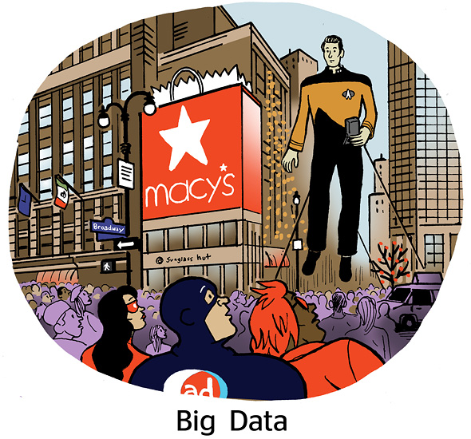
There’s Big Data And Then There is Big Data!
CSCI3907/CSCI6444 - Big Data and Analytics
8-<number>
Notes:
Commander Data from Star Trek: Next Generation

Slide 5
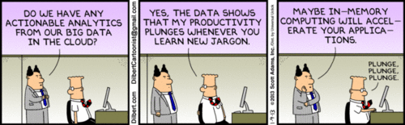
Big Data: Issues and challenges
Analytics have been focused on business problems – the low hanging fruit!
The really tough problems lie ahead and the key will be advanced analytics.
Data Mining only carries us so far in understanding our data due to lack of domain knowledge.
What percentage of applications really need Big Data analytics?
  This is not clear; no comprehensive study
  The lemming syndrome
CSCI3907/CSCI6444 - Big Data and Analytics
8-<number>
Notes:
Analytics – the methods we applied to analyze data and generate results to solve problems – have been around since women and men have been sentient creatures.
The term “analytics”, as we remarked at the beginning of the course, is overloaded and, sometimes, abused.
A lot of effort in the blogs and online media has focused on business applications and on the low-hanging fruit – the problems that are relatively simple and admit to easy methods of data science (my opinion!). Many such problems use just one method to analyze the data.
But, there are many difficult, complex problems that require extensive analysis and multiple methods, including advanced methods – of which you got a taste in lectures 11 and 12 – that are now being attacked. Some of these have been researched for years, but have not been widely reported on because they are not popular or deemed popularly interesting.
An open question – good for Master’s Theses and Doctoral dissertations – is how many problems really require Data Science.
So, let’s begin at looking at some of the issues and challenges.

Slide 6
Big Data Acquisition and Storage - I
Has quality control been maintained throughout the acquisition of the data? If not, are quality control parameters clearly identified for different data subsets?
What validation and verification procedures were used during data acquisition?
How to handle data lost during the data acquisition process? Due to acceptance and/or storage problems?
Guaranteeing reliability and accessibility of data given the axiom of maintaining one copy of data, not many (Feinleb 2012).
CSCI3907/CSCI6444 - Big Data and Analytics
13-<number>
Notes:
As we noted early one, we are talking about data in the Petabyte to Exabyte range now, with Zettabyte volumes of data for certain problems coming in the near future.
Where does that data come from, how are we going to get it into storage, and do we have enough storage?
- Our communications channels are limited to 10s of Gbytes
No computer system today stores more than Exabyte's (except one in China that has been reported). The best that you can do on a home tower is several 10s of Tbytes.
I will mention this again and again: Provenance of data: how it was collected, how it was handled through each stage of processing and analysis until you report on it is a critical challenge. For some applications there are legal ramifications.
Note that if you have one copy, you risk catastrophic loss. But, if you replicate it, the costs – considering Pbytes – can be enormous. This is a significant tradeoff.

Slide 7
Big Data Acquisition and Storage - II
How does one drive the acquisition of high-value data?
A corollary to the above: How does one predict what data is needed to plan, design, and engineer systems to acquire it?
How does one decide what data to keep?
  For example, what data is relevant, if it cannot all be kept?
How does one access and manage highly distributed data sources?
CSCI3907/CSCI6444 - Big Data and Analytics
13-<number>
Notes:
Axiom: Not all data is valuable to every one.
Axiom: But all data may be valuable to some one.
Some data is more valuable to solving an aspect of a problem than other data.
If you can only collect so much, how do you know what is the high-value data?
How do you plan to acquire it, realizing that high-value data may be more expensive to collect?
A critical question is how much data can you keep – afford to, physically store, manage?
What data is relevant to you problem?
Maybe you store all the data, but only download locally what you really need.
How do you manage large volumes of data?
In most cases – at the petabyte range, you will require a distributed system (w/ data replication) to store it and to make it easily accessible.

Slide 8
Data Curation: Issues and Challenges - I
Know your data – both what you acquire and what you generate.
  Develop an acquisition plan, a storage plan, a management plan, and a retirement plan.
  Authenticate the data with metadata so its provenance is established.
Creating data – for data you generate, associate the appropriate metadata with it.
Determine accessibility and use.
  Identify the classes of users of the data, what they can and cannot use, and what the accessibility constraints on the data are and how they will be enforced.
  Check periodically to ensure that the data is accessible and uncorrupted.
CSCI3907/CSCI6444 - Big Data and Analytics
13-<number>
Notes:
Data curation is the management of data throughout its lifecycle, from creation and initial storage to the time when it is archived for posterity or becomes obsolete and is deleted.
Computer scientists seem to think this is a topic for information systems management.
And so, we don’t talk about it.
But, it is a critical issue and challenge we must deal with.
When you begin a project to solve a problem you need several plans as mentioned above.
Note that you can’t just plan for the data that you collect, but the data that you generate as a result of your cleansing and analysis.
Managing data means knowing who can access it (and use it), who can modify it, who can delete it.
Management also involves focusing on the security of your data.

Slide 9
Data Curation: Issues and Challenges - II
Establish selection criteria:
  You may not be able to keep all of the data that you acquire.
  Determine what data you will keep based on its relevancy to the organization’s mission and operation.
  Consider perishability – how useful the data is/will be after a given time period.
Preserving the data:
  Ensuring the data is available, protected, and backed up so if the primary store is lost, the data will be recoverable.
Data visualization will only prove to be a valuable tool if the data quality is assured.
Retention of Data:
  What are the legal requirements for retaining the data? For a fixed period? For a long time? Forever?
CSCI3907/CSCI6444 - Big Data and Analytics
13-<number>
Notes:
If you can’t keep all of your data, what selection criteria do you use to downselect the data you keep?
Is this acceptable to all users of the data?
As part of its metadata, you should tag it with some notation of the selection criteria applied.
And, where do you apply the selection criteria – where it is collected, where it is cleansed, or where it is stored permanently?
You need to develop an accessibility plan if there are multiple (potential) users of the data.
This may involve replication of the data in different distributed systems.
But, managing distributed, replicated data has its own problems:
How many copies?
Where are the copies stored?
When data is updated, how do you distribute updates to the replicated copies?

Slide 10
Data Curation: Issues and Challenges - III
Disposal Plan and Operations – it is not simply a matter of erasing digital data or throwing paper or other media in a recycling bin.
  Some data is sensitive and must be properly discarded – shredding of paper and other media, overwriting data stores with zeroes, etc.
  Periodically appraise your data to determine if it is still relevant and useful for your organization’s mission and operations.
Access to the Data – is access to the data limited by law?
  For example, HIPAA and the Privacy Act (amended) restrict access to personal data through personal identifiable information (PII).
  [Data that in itself or combined with other information can identify, contact, or locate a specific person, or an individual in a context.]
CSCI3907/CSCI6444 - Big Data and Analytics
13-<number>
Notes:
At some point, your project will come to an end. Most academic projects do.
There has been a tremendous loss of valuable information when this happens. Because data, programs, plans, reports are often discarded w/out thinking about the historical value.
If data is sensitive, then you need to have a disposal plan that shows you will properly dispose of and a verification procedure to ensure that you did.
You should periodically review the data you have stored so see if some of its obsolete and can be archived or disposed of – as appropriate.
There are Federal laws and regulations that govern collection, access, and retention of certain types of data:
Personal Identifying Information (PII) is one
Health data is another.
You can combine disparate pieces of data from different sources, such that the combined data becomes PII.

Slide 11
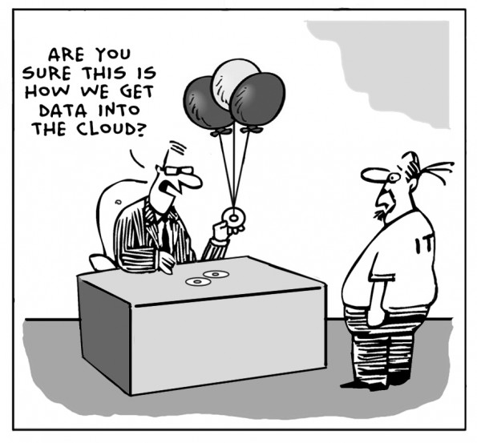
Data Curation: Ingesting Data
Ingest the data – including cleaning and transforming prior to storing it.
  It may be desirable or necessary to transform the data into a different digital format before storing it – based on its intended use or efficiency of storage.
CSCI 3907-80/CSCI 6444-10-10 Big Data and Analytics
8-<number>
Notes:
When you are acquiring data, you should have a plan for how the data is to be organized when you store it.
Throwing data into a data lake seems to be a good idea, but may make it difficult to manage it and know what you have.
You also need to decide whether you will cleanse, transform (and enrich) data as you acquire it, or do so after you have stored it.

Slide 12
Data Cleansing: Issues and Challenges - I
Validity: A measure of the conformance of data to the criteria set established for useful data within the organization.
  Each data set should have a set of validity criteria and a mechanism for establishing the validity of each element.
  If the data set is refreshed – either periodically or continually – then, the validity criteria should be checked on the same schedule.
Retention: Although data has been removed from the data set, should it be retained?
  For example, there may be legal requirements to retain the original data set even though the cleansed data set is used in further processing.
Duplicate Removal: Removal of duplicates is often performed through data correction or outright removal.
  However, there may not be enough information available to determine whether duplicate removal should occur. The risk is loss of information.
CSCI3907/CSCI6444 - Big Data and Analytics
13-<number>
Notes:
When you remove data from the data set, do you want to retain it or not.
You should always beware of any legal requirements for retaining data.
Some data have continuing relevance for longitudinal studies and should be archived.
Other data may have been updated and may not need to be retained online, and can be moved offline to free up storage space.
If you retire data from your primary repository, then you should also remove any duplicates. If you have archived the data, you can always restore it at some future point.

Slide 13
Data Cleansing: Issues and Challenges - II
Streaming Data: Cleansing of streaming data is problematic for at least two reasons.
  First, decision about correction, transformation,, and duplicate removal have to be made within a short time frame and, often, with insufficient information.
  Second, if the data re-occurs, a question arises as to whether the earlier cleansing was the right decision.
User Perspective: Different users may have different perspectives on how data should be cleansed for a particular problem.
  For example, the question of “how many employees do we have” should result in different answers depending on the person asking the question.
  This implies that different versions of the data set must be maintained to satisfy different user perspectives.
CSCI3907/CSCI6444 - Big Data and Analytics
13-<number>
Notes:
Streaming is a tough problem:
Some data comes in fast and you have just enough time to store it or pass it down the line.
Other data comes in at measured intervals and you have time to cleanse and transform it.
Different users may want data cleansed in different ways, so you should plan to store the raw data and, perhaps, cleanse it later.
Storing the raw data allows you to cleanse it in different ways for different users at different times. Thus, an initial cleansing may give way to different methods months or years later.
Some streaming data is perishable in some time interval after it has acquired. For example, Airport Ground Control Radar data is relevant immediately when a flight takes off or lands, but within some period thereafter can be properly disposed of. This interval may be a day to a few weeks. Depending on local, state, and federal laws and regulations.

Slide 14
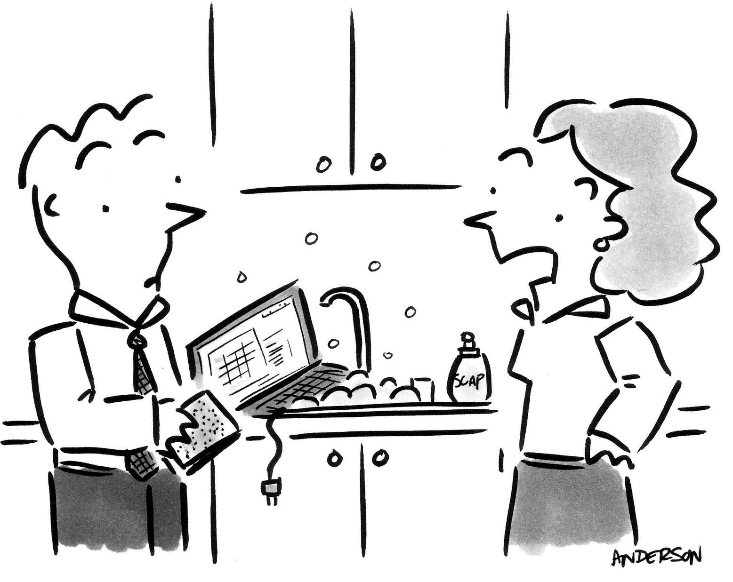
This is not what I meant when I said we need better data cleansing!
CSCI3907/CSCI6444 - Big Data and Analytics
8-<number>
Notes:
Don’t try this at home, please!

Slide 15
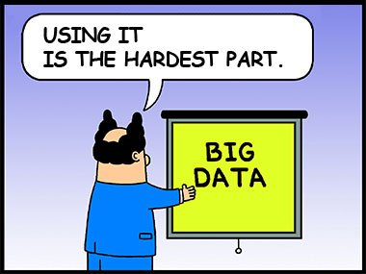
Using the Data
Data Homogenization: Sometimes, data must be homogenized to eliminate bias due to data collection methodologies, variability in instruments – whether physical or textual, such as opinion survey instruments.
  Homogenization is a transformation of a data to a base value with scaling to ensure the data all represents the same phenomena.
CSCI3907/CSCI6444 - Big Data and Analytics
13-<number>
Notes:
Data homogenization is not normalization.
Rather, it is rescaling data to a base value. For example, to make mixed negative and positive numerical data, scale it by adding the absolute value of the largest (farthest away from zero) to each element of the data set. Then, the largest negative value becomes zero and all else is greater than zero.
With text data, you might want to replace synonyms of base words with the base word.
But, you need to be careful of nuances in word usage as such a substitution may change the meaning of the sentence from the author’s intent.
In Project #2, you had some NA data which you transformed to zeroes.

Slide 16
Big Data: Management Challenges - I
Are the data characteristics sufficiently documented in the metadata?
  If not, how difficult is it to find them?
If all the data cannot be stored, how does one filter, censor, process data to store only the most relevant data?
Can ETL (extract, transform, load) be performed on all data without resorting to external mass storage?
How much data enrichment must be performed before the data can be analyzed for a specific problem?
CSCI3907/CSCI6444 - Big Data and Analytics
13-<number>
Notes:
Metadata describes data such as who, when, where, how, why collected.
Sometimes you need metadata for each data item, such as instrument settings, which can vary during the data collection process.
Metadata is part of the Provenance of Data.
One management challenge: can you store all data in memory when you are analyzing it?
If not, then you need to stage it through memory in chunks.
Another issue is data enrichment.
In order to use data in analysis, you may need to enrich, i.e., add data from existing data bases. Enrichment can fill in missing data items, augment data with additional information, create links among data items, help correct spelling, add other attributes, etc.
Data enrichment contributes to a better baseline for analysis.
But, make sure you are enriching with the appropriate data at scale, precision, reliability, accuracy, etc.

Slide 17
Big Data: Management Challenges - II
Determining the amount of enrichment to perform on acquired data such that it does not skew or perturb the results from the original data.
How does one handle outliers and uncorrelated data?
Where is the tradeoff between integration of diverse data (multimedia, text, and web) versus more complex analytics on multiple data sets?
  What transformations do you need to make to integrate data into one repository?
What visualization techniques will help to understand the extent and diversity of the data?
CSCI3907/CSCI6444 - Big Data and Analytics
13-<number>
Notes:
Enrichment is a contentious issue among some data scientists.
Some prefer to use just the raw (or lightly cleansed data), while others want the richest data set they can get – even if it is augmented by already known data.
Handling outliers and uncorrelated data is another contentious issue.
Some data scientists try to reduce everything to numbers it integrated the data into one massive data set. Others believe data should be retained in its own data type, even though it makes analytical programs more complex and difficult to develop.
I showed you the Periodic Table of Visualization techniques in Lecture 3.
Choosing visualization techniques is an art and, often, personal preference.
But, you should explore different techniques to see what fits your needs the best.

Slide 18

Big Data: Quality vs. Quantity - I
As users obtain more data, they want more.
Note: For some users, data acquisition is an addiction
Perhaps, because they believe that with enough data, they will be able to perfectly explain whatever phenomenon they are interested in.
Recent focus on quality which means not having all the data available, but having a (very) large quantity of high quality data that can be used to draw precise and high-valued conclusions.
Data!
I need more data!
CSCI3907/CSCI6444 - Big Data and Analytics
13-<number>
Notes:
The picture is Ally Sheedy and robot Number Five in the movie Short Circuit.
Number Five is struck by lightning, then develops intelligence and a voracious appetite for knowledge.
Seethe Trailer: https://www.youtube.com/watch?v=n957TZXYM58
Many people think that with enough data they can thoroughly explain a particular event or phenomenon.
This seems to me to be a fallacious assumption.
Rather, focus on high-quality data. Get as much as you can handle, but no more, and do the best analysis that you can.
We don’t have a Data Anonymous for people with data addiction, but maybe we should have.

Slide 19
Big Data: Quality vs. Quantity - II
How do we decide which data is irrelevant versus selecting the most relevant data?
How do we ensure that all data of a given type is reliable and accurate?
  Or, maybe just approximately accurate?
How much data is enough to make an estimate or prediction of a specific probability and accuracy for a given event?
How do we assess the “value” of data in decision making?
  Is more necessarily better?
CSCI3907/CSCI6444 - Big Data and Analytics
13-<number>
Notes:
These are all critical questions:
How much data do you really need to make a good analysis? There are no heuristics or guidelines. It is mostly “seat of the pants” estimates.
Similarly, the last bullet asks how much value different types of data contribute to solving a problem. Sensitivity analysis helps in some cases. But, this is an open research question – good Doctoral dissertation(s) here!!!
Accuracy in data is very important.
Axiom: You cannot make good decisions with bad data.
Axiom: Lots of people make bad decisions with bad data.
George Michael, one of the Fathers of Supercomputing: Prefer Quality of Cycles over Quantity of Cycles in Computing (circa 1983).
Some analyses require precision, accuracy, fidelity, reliability because the quality of the decision is important. In law enforcement and health and space exploration, these are all important.
Bullet 3 is a variation of bullet 1. Here, of course, we are asking how much data is necessary to narrow the margins on the probability of the outcomes.

Slide 20
Big Data: Compliance Challenges – I
What rules and regulations should exist for combining data from multiple sources about individuals into a single repository?
Do compliance laws (such as HIPAA, Sarbanes-Oxley, …) apply to the entire data warehouse or just to those parts containing relevant data?
What rules and regulations should exist for prohibiting the collection and storage of data about individuals – either centralized or distributed?
Should an aggregation of data be secured at a higher level than its constituent elements?
CSCI3907/CSCI6444 - Big Data and Analytics
13-<number>
Notes:
Compliance with an array of laws, rules, and regulations is a critical aspect of data management and analysis.
Axiom: Know the regulations that (may) govern your data!
We have alluded to these in previous slides, but they need repeating and re-emphasizing – both for academic purposes as well as legal purposes.
The next slide looks at Ethical Challenges in using Big Data.

Slide 21
Big Data: Ethical Challenges - I
Should we use data without the permission of individual owners, such as copying publicly available data?
Are we required to inform individuals of the use of their personal data?
Are we required to respect their privacy even on publicly accessible web sites such as Facebook, MySpace, YouTube, Reddit, Pinterest, etc.?
Are we required to check the accuracy of what is posted on a publicly available web site before using it?
What penalties should transpire for the misuse of publicly available data for criminal purposes?
  Should the penalties be harsher for private data obtained?
CSCI3907/CSCI6444 - Big Data and Analytics
13-<number>
Notes:
Another set of critical questions:
Public data does not imply free usage – necessarily – but that you can look at it.
Data on Facebook, on Instagram, on Twitter is public to the extent the owners make it so, but they give you permission to use it as your own. You must/should ask first!
Facebook lost this battle in court, but still abuses the use of data placed on their pages.
The last bullet is important; If you gather data about a person and use it with criminal intent, what should be the penalties? This is an unsettled area of law which will come to a head within the next few years as more and more people post online.
Axiom: Do not post personal data on publicly available social media!!

Slide 22
Big Data: Ethical Challenges - II
How can we prevent the use of big data to harass or abuse culturally sensitive groups?
  Such as fostering racial prejudices or gender stereotypes?
What penalties should be imposed for failing to correct errors in acquired data and derived results even after proper notification?
Can we prevent the dissemination of data and derived results that are not in the best interest of the public to know?
Will big data be used to target and harass protesters who are exercising their right to protest (as guaranteed by the U.S Constitution)?
How much and what types of data collected by the government or by private industry (such as the social media providers) should be made publicly available?
  Should the government have access to private social media?
CSCI3907/CSCI6444 - Big Data and Analytics
13-<number>
Notes:
With publicly available data being posted on Facebook, Twitter, Instagram, etc., how can we prevent people from copying it, modifying it, and using it to harass or abuse people.
We need new laws to handle these types of situations.
There have been several cases of academic fraud reported, There have been cases of commercial disinformation (possibly fraud) and, of course, a substantial number of lies and disinformation in the current political arena.
Few of these incidents have been subjected to legal enforcement; perhaps some should be, but this will require a change in the law.
There are several cases of bullet 3 and many of bullet 4. Some laws cover bullet 4, but stricter laws may be required.

Slide 23
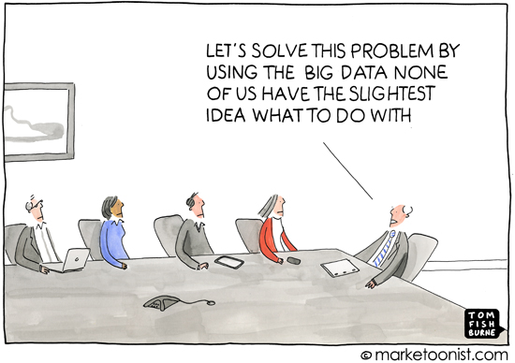
Big Data: Using the Data
It takes a lot of understanding to get data in the right shape so that you can use visualization as part of data analysis.
CSCI3907/CSCI6444 - Big Data and Analytics
8-<number>
Notes:
Just to repeat, data curation is essential to being able to use data for analysis of problems (of any type).
We didn’t talk about it much due to lack of time, but you should consider taking an external course in it after you graduate and if you continue into Data Science.
Note: We do not offer a course in it here at GWU (sadly!).

Slide 24
Analytics: Critical Ideas - I
Feinleb (2012) has noted that the faster one analyzes data, the greater its predictive value.
  Near real-time processing of streaming data allows the detection of trends within the OODA (observe, orient, decide, act) loop of both customers and managers.
Tools used in Big Data analysis continue to evolve at a rapid pace and new tools are constantly emerging.
  Tool churning is leading to conflicts in assessing and evaluating the best approaches to Big Data analysis.
  It also, to some extent, obscures new analytical approaches by requiring analytical approaches to fit into the state-of-the-art tool suite and framework
Tolerant Analysis – you are typically doing open-world reasoning when processing data
  Things go away
  Contradiction is present
  Data is incomplete and may be erroneous/noisy
  Surveying the KB may not/is not possible (it is too large!!)
  Need substantial deep and shallow knowledge domain knowledge to reason effectively
CSCI3907/CSCI6444 - Big Data and Analytics
13-<number>
Notes:
Some data is perishable. If you intend to use it, you must analyze it within the time frame of the decision-making process in which it will be used.
There is significant churn in the use of tools for data science and data analysis.
Why is that? Possibly because the tools we have at hand do not do everything we need to do. And, we continue to search for better tools.
Axioms:
The grass is not always greener on the other side of the fence.
(Use the tools that you have and know how to work with rather than continually jumping around trying to find better ones.)
You have to dance with the one you brought to the dance.
(As Don Rumsfeld said: “you go to war with the Army you have!” So, work with the tools you have when trying to solve a problem, then look for better ones.)
Remember: The environment around you is constantly changing!
And, uncertainty is ever present
Adaption to you present circumstances is the best strategy.

Slide 25
Analytics: Critical Ideas - II
There are few metrics for assessing tools or assessing analytical techniques and mapping outputs (of tools) to outcomes (of analytical approaches).
  Specialized metrics for specific domains will be required to assess analytical approaches
While cloud computing seems to be the current preferred infrastructure architecture for processing Big Data, scalability remains an issue.
  Limitations on Hadoop MapReduce versus Spark
  Bandwidth problems
  Disk performance
  Batch only
  Streaming
CSCI3907/CSCI6444 - Big Data and Analytics
13-<number>
Notes:
This is an important problem which we mentioned before, but do so again:
How do we measure the value contributed by different data (items, sets, types) to making a decision.
We need metrics (and a theory or two or more…). This is an area of open research.
Good area for Doctoral Research!!
Yes, we can scale, but how do we scale the processing of complex problems with many interdependent parts? It is not just a simple matter of replicating programs and/or processes across many processors ( a la MapReduce).
One needs to think about both system and software architecture.
And yet, many researchers do not have the background to address these problems adequately.

Slide 26
Analytics: Issues and Challenges - I
Quantity versus Quality: What data are required to satisfy a given value proposition?
  At what precision and accuracy?
Tracking provenance from data generation through data preparation and processing to derived data/information?
  How do we backtrack from results to raw data?
Performing data validation and verification, including accuracy, precision, and reliability?
  Are we responsible for these features if we use the data?
Coping with sampling biases and heterogeneity
Using more diverse data, not just more data (Feinleb 2012)
CSCI3907/CSCI6444 - Big Data and Analytics
13-<number>
Notes:
George Michael, one of the Fathers of Supercomputing, gave me this axiom:
Axiom: Quality of cycles is more important than quantity!
He meant that how you focus your available computing resources on the problem is more important than just have fast computers with lots of memory.
What this comes down to is using the best tools, best algorithms, best data, and best thinking to solving a problem. You may not need lots of cycles, lots of data, or lots of tools – if you know how to use what you have very proficiently.
Bullet 2: How do we walk back from the results to find out which data is the best causal explanation? That is, how do we trace from a result or prediction back to the raw data which, after suitable transformations, supports the result or prediction.
How do we build such mechanism into analytic tools? This is a software architecture problem.
Bullet 4: We all have biases in collection and analysis. Know what yours are so you can avoid misleading your analysis.

Slide 27
Analytics: Issues and Challenges - II
Working with and integrating data having different formats and analytics requiring different formats and structures.
Developing scalable algorithms to exploit current and emerging parallel and distributed architectures
Developing methods for visualizing massive data
Ensuring data sharing with security and integrity
Axiom: Understand that approximate results given limited computational capacity are better than no results.
Conjecture: Is more data better than better algorithms?
  With what reliability, precision, accuracy, fidelity?
CSCI3907/CSCI6444 - Big Data and Analytics
13-<number>
Notes:
Bullet 5: You will never have the optimal environment to perform analysis.
So, do the best you can to get results that are explanatory, defensible, and usable.
Axiom: Lack of absolute precision is NOT a failing, if it is the best that you can do.
The conjecture is one that generates considerable discussion and disagreement.
Does more of the same type of data guarantee a better result?
Maybe, in a few cases. My colleagues and I think more diversity in data – even if you have less data, is usually better.
As I said previously:
Axiom: good algorithms cannot make up for bad data.
If you don’t have good data (or really good data), it may not be worthwhile to try and solve the problem.
Not that has ever stopped most human beings. Read about the Darwin Awards to see many examples of this phenomenon.

Slide 28
Analytics: Issues and Challenges - III
Resolving Social ROI
  Many Big Data problems are social problems
  How to translate changes in the social milieu into financial metrics?
  For example, how do we measure the impact of social engineering programs – whether housing, education, health and human services, …
  What performance metrics should we use?
  Are these common across social engineering programs or different for each discipline?
CSCI3907/CSCI6444 - Big Data and Analytics
13-<number>
Notes:
Many of the really hard problems are in social science:
When we approach data analysis, we need to ask what is the Return-On-Investment in try to do the analysis and sole the problem.
Some problems are not wholly solvable, only partially. See Wicked Problems!
Many data scientists are trying to monetize the results they achieve. This is the driver behind commercial sentiment analysis, among others.
Measuring the impact of social engineering programs is difficult. I ran a study for US Army Corps of Engineers called “Outputs to Outcomes” to try and tie US AID program outputs and results to desired outcomes. It is tough.
Water well example!! Given last week.

Slide 29
Analytics: Infrastructure Issues - I
Mobile Analytics at the Edge:
  How do you allow for true data manipulation within the confines of such a small area to interact with the device?
  Even with cell phones and tablets becoming more powerful.
  Mobile devices are great for dashboards, but the user interfaces only support high level and read-only visualizations
I/O will remain a critical problem, even after memory becomes unlimited:
  Reading several TBytes of data from disk is a slow process
  Suppose we could read 1/100th of the data from 100 disks which will take 1/100th of the time
  But, the challenge is how to stage the data to each of those 100 disks and keep it continually updated.
  Some or all of the data may be replicated across multiple machines to provide some degree of fault tolerance
CSCI3907/CSCI6444 - Big Data and Analytics
13-<number>
Notes:
One of the very hot areas in data science is computing at the edge, e.g., where the data is generated and collected.
A primary focus has been on analytics that can run on cell phones and other mobile devices and provide near real-time results to the owner/user.
Bullet 2 is critical: Even with high-speed WIFI, we are still somewhat bandwidth limited.
Mobile device screen area can limit the effective use of visualization, even with improved resolution of mobile device screens.

Slide 30
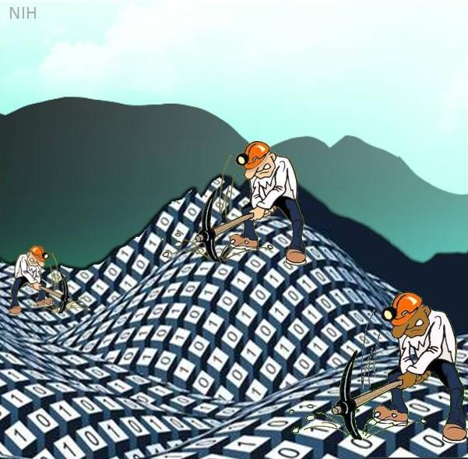
Analytics: Infrastructure Challenges - I
Everybody says move the computation to the data, but this is often not easy
  Often time-consuming: network bandwidth and overhead, disk access time, communication and synchronization
Data Mining
CSCI3907/CSCI6444 - Big Data and Analytics
13-<number>
Notes:
How do you move Tbytes across low Gbyte/second networks?
Tbits/second networks are only now emerging from research laboratories. There is a physical limitation at which you can send electrons through a wire or photons down an optical fiber.
And then you have disk access times, disk transfer times inside the computer, etc.
Only if you have many parallel channels and machines at both ends that can disaggregate and re-aggregate the data.
Note: This is all about system architecture before you even think about doing analysis.
Axiom: A Good System/Software Architecture can make your analysis process easier.

Slide 31
Analytics: Infrastructure Challenges - II
If you need a single record from a large data set, it is relatively easy if you have it indexed properly.
However, analyzing the whole data set, with each record fetched several times is a lot harder
  Consider moving the data set into memory and re-indexing it.
Note: most data mining/machine learning subsystems were designed without considering:
  Data access
  Communication and synchronization
  Communicating the results
  Operating system idiosyncrasies
CSCI3907/CSCI6444 - Big Data and Analytics
13-<number>
Notes:
If you data set is static, then you need to index it only once – whether you can do it in memory or piecemeal between memory and disk.
However, if your data is changing periodically, then you should consider re-indexing it after you apply all of the updates.
Dynamic re-indexing for (near) real-time data is a significant engineering challenge. New algorithms will be needed for massive data sets.
Senate FMS Example!! Given earlier in Lecture 6.

Slide 32
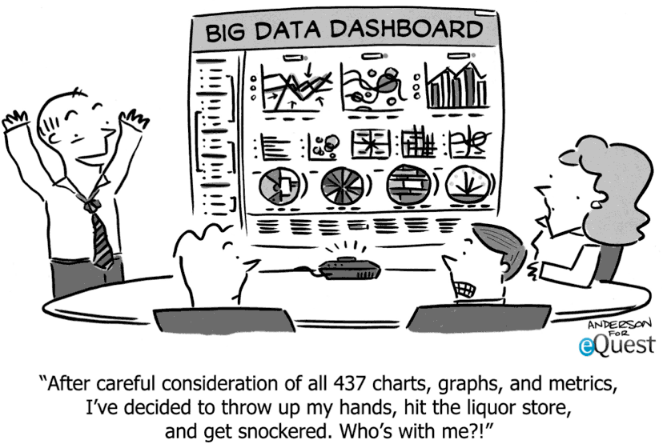
Big Data: The Visualization Problem
CSCI3907/CSCI6444 - Big Data and Analytics
8-<number>
Notes:
Good visualization helps to convey the findings to the end user/decision maker.
Even with the best analysis that solves the problem, poor data/information visualization will detract from the results.
Layer your visualization! Do not smother your target with Death by PowerPoint
(Professors get some leeway, however).

Slide 33
Analytics: Where will the Breakthroughs Come From?
To have technical breakthroughs for Big Data Analytics, you must know algorithms and systems very well!
  Many machine learning students do not know systems at all, because it is outside their degree track.
Need to delve into the fundamental details of implementing a particular algorithm:
  Pay attention to data access and communication
Sometimes, updates and versions come fast and furious to an open source software library
  Spend the time to understand the changes at the lower levels
But, REMEMBER that analytics is only one piece of the Big Data Workflow
CSCI3907/CSCI6444 - Big Data and Analytics
13-<number>
Notes:
Re: Bullet 2: At Los Alamos, Lawrence Livermore and other supercomputing sites, extensive attention to detail and “optimization” of algorithms can yield better end-to-end computing times.
This can also lead to insights which lead to new algorithms.
Remember: Data Science fits within a larger environment/ecosystem.

Slide 34
What Are Grand Challenges?
Definition: A specific scientific or technological innovation that would remove a critical barrier to solving an important domain problem with a high likelihood of global impact and feasibility.
  Provide scope for engineering ambition to build something that has never been seen before.
  Generally comprehensible, and capture the imagination of the general public, as well as the esteem of scientists in other disciplines.
  Go beyond what is initially possible, and requires development of understanding, techniques and tools unknown at the start of the project.
  Since these first appeared in the 80s, they abound in every science and discipline!
Not just a restatement of the many “big problems” facing the world today
  Are they equivalent to Wicked Problems?, or are
  Grand Challenges Wicked Problems?
A tool for focusing investigators working towards overcoming one or more bottlenecks in a foreseeable path toward a solution to significant domain problems.
CSCI3907/CSCI6444 - Big Data and Analytics
13-<number>
Notes:
Back in the 1980s, during the Reagan Administration, the notion of Grand Challenges was created to spur innovation and research in Supercomputing.
DARPA also created the Strategic Computing Program in which I was a Program Manager in High Performance Computing and Naval Command and Control applications.
A few of the grand challenges have been solved over time, a few still remain.
But, the idea took hold and now there are grand challenges in almost every discipline. Do a web search and you will see.

Slide 35
Some Grand Challenges
Reversing poverty
Conquering Disease (Cancer, Obesity, Mental Illness)
The Singularity:
  Machine intelligence will accelerate its learning and potentially overwhelm human intelligence.
  See the movie “Colossus: The Forbin Project” and novel by D.F. Jones
  See Trailer: https://www.youtube.com/watch?v=kyOEwiQhzMI
Exploring Transhumanism:
  Technology will enable us to live longer, learn more, and augment our bodies in different ways.
Know The Earth: modeling the planet’s ecosystems in order to save it.
CSCI3907/CSCI6444 - Big Data and Analytics
13-<number>
Notes:
These are a few to whet your appetite.
There is a great potential here for research and doctoral dissertations.
Is Transhumanism a good idea? Would you want a chip in your brain?
Know the Earth: This was an NGA program to be able to understand earth’s terrain, weather, ecosystems in the interests of National Security.

Slide 36

Wicked Problems
In 1973, Horst Rittel and Melvin Webber formally described the concept of wicked problems.
Conventional problem solving methods, rooted in 18th century physics, economics and engineering, focused on efficiency.
Societal problems are fundamentally different from the types of problems that scientists and engineers deal with.
Societal problems are wicked problems.
CSCI3907/CSCI6444 - Big Data and Analytics
13-<number>
Notes:
I just happen to really like the musical “Wicked”
If you haven’t seen it, try to.
The last bullet says it all.
But, see the next slide.

Slide 37
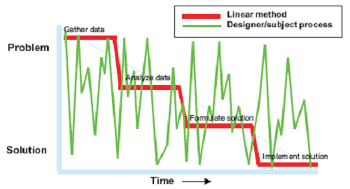
Tenets of Wicked Problems
No general agreement on what the problem is.
You don’t understand the problem until you develop a solution.
Wicked problems have no stopping rule.
Solutions to wicked problems are not right or wrong.
Every wicked problem is essentially novel and unique.
Every solution to a wicked problem is a 'one shot operation‘.
Wicked problems have no given alternative solutions.
Causes and Effects are Elusive
Sensitive to Initial and Boundary Conditions (History)
Figure 3. Wicked Problems (Conklin, 2005)
CSCI3907/CSCI6444 - Big Data and Analytics
13-<number>
Notes:
These are commonly agreed upon tenets of Wicked Problems.
They may seem negative, but that is not the case.
They are extremely challenging and may/will be solved in time.
Consider “nuclear fusion” and the ability to have near unlimited power. We are much closer than we were 50 years or 30 years or even 10 years ago.
But, we do not yet have a viable, commercial solution.
Is it just an engineering problem?
What about “Warp Drives” a la Star Trek?
What about Global Terrorism? On one level, we think it is ideological, but it has a basis in religion, in psychology, in economics, in culture, etc.
How do you address all of those fundamentals?

Slide 38
Some Wicked Problems
Infrastructure Resilience
Climate Change
Defeating Cyberterrorism
“Peaking” Oil or Coal: When does it run out?
The “Long War”: Is there an end to terrorism?
Sustainable Cities and Ecosystems
Sustainable Development in the Third World
Affordable Health Maintenance for an Aging Society
Transitioning to Democracy and Beyond
  Predicting the next “Arab Spring”
Biological and Genetic Threats and Opportunities
Will an Ebola/Coronavirus vaccine change world health?
Reducing the U.S. Debt
Discover drugs that minimize disease-resistant micro-organisms
CSCI3907/CSCI6444 - Big Data and Analytics
13-<number>
Notes:
All of these are interesting research problems that exist at the intersection of Computer Science with other sciences and disciplines.
Lots of good Doctoral Research opportunities here.

Slide 39
Challenges: End-to-End Systems
Wicked Problems will require an end-to-end system approach:
  Multiple analytics: cascade or mesh or other topology for the analytic architecture
    Why? Different types of data (may) require different approaches
  Need a robust, reliable computing/infrastructure environment
    Pipelines are a relatively simple model; may not be adequate for complexity of problem
Must consider end-to-end behavior:
  Bottlenecks
  Data conversion, transfer, & loading overheads
  Storage costs & other parts of the data life-cycle
  Resource management challenges
  Total Cost of Ownership (TCO)
CSCI3907/CSCI6444 - Big Data and Analytics
13-<number>
Notes:
It seems that wicked problems will not be solved by one analytic, but application of a sequence of analytics looking at the different aspects of the problem.
Thus, we need different software architectures and frameworks in which to embed these analytics.
See my book: Software Paradigms
Complexity begets other problems some of which are cited in bullet 2.

Slide 40

Black Swan Problems
A Black Swan event is a highly improbable event:
  It is unpredictable, an outlier, that lies outside the realm of regular expectations
  It carries massive impact or disruption
  After the fact, we concoct an explanation that makes it appear less random and more predictable, than it actually was.
Some Black Swan events:
  The success of the Web
  September 9/11
Axiom: The absence or non-occurrence of a highly probable event is also a Black Swan.
Ref: Nassim Taleb, 2007
CSCI3907/CSCI6444 - Big Data and Analytics
13-<number>
Notes:
Note: This is NOT the Natalie Portman movie!!
Nassim Taleb is a highly respected New York Times Science journalist.
Sherlock Holmes and The Hound of the Baskervilles

Slide 41
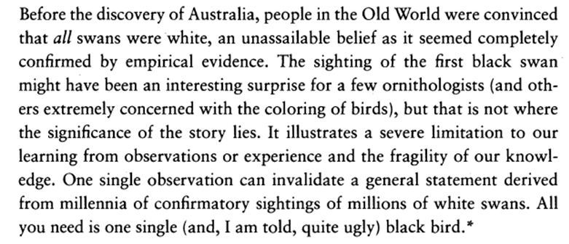
The Black Swan
Can you think of other examples of Black Swan’s?
CSCI3907/CSCI6444 - Big Data and Analytics
13-<number>

Slide 42

Is this ….?
Oooops! We mean the Exabyte Age! Er, the Zettabyte Age!
CSCI3907/CSCI6444 - Big Data and Analytics
13-<number>
Notes:
So, does “Data Science” mean the end of classical science – experimentation and theory and, now, simulation.
Is everything just reduced to numbers and statistics?
IMHO: No, statistics does not impute causality nor does it impute explanation. That is the realm of human cognition and understanding.
As we have shown, there are complex problems that are going to require new theories, new analytical techniques, better data, and deeper understanding to solve – and the will to solve them – either wholly or partially.
To paraphrase the goal of the Starship Enterprise was: “To go where no one has gone before, to explore new worlds, and new ideas, that is the mission we have before us as Computer Scientists in conjunction with different scientific and social disciplines.”

Slide 43
With loads of data
you will find relationships that aren’t real.
Big data isn’t about bits,
it’s about talent.
Forbes Magazine
To put it bluntly
It’s all about you!
CSCI3907/CSCI6444 - Big Data and Analytics
13-<number>
Notes:
As you train after this course and others and after you graduate from GWU, and other schools
Never stop Learning!
Always ask yourself: What is something new that I learned today?
And, What can I learn tomorrow?
Life-long learning is a gift and an opportunity – make the most of it.

Slide 44
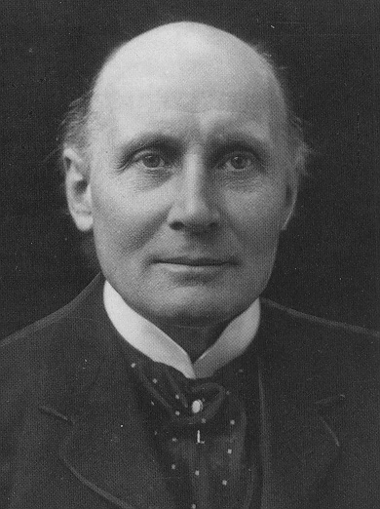
One Final Word!
We have a tendency to mistake our models for
reality, especially when they are good models.
Axiom: Models are not Ground Truth!!
Alfred North Whitehead
CSCI3907/CSCI6444 - Big Data and Analytics
13-<number>
Notes:
The only accurate model is reality itself!!

Slide 45
References
Kaisler, S., F. Armour, A. Espinosa, and W. Money. 2013. “Big Data: Issues and Challenges Moving Forward”, 46th Hawaii International Conference on System Sciences, Grand Wailea, Maui, HI
Kaisler, S., F. Armour, A. Espinosa, and W. Money. 2014. “Advanced Analytics: Issues and Challenges in the Global Environment”, 47th Hawaii International Conference on System Sciences, Hilton Waikoloa, Big Island, HI
N. Taleb. 2007. The Black Swan: The Impact of the Highly Probable?
Feinleb, D. (2012) Big Data Trends. Retrieved November 10, 2013 from http://thebigdatagroup.com/
National Academy of Science. (2013) Frontiers in Massive Data Analysis, Retrieved November 1, 2013 from http://www.nap.edu, Washington, DC: National Academies Press
CSCI3907/CSCI6444 - Big Data and Analytics
13-<number>

Slide 46
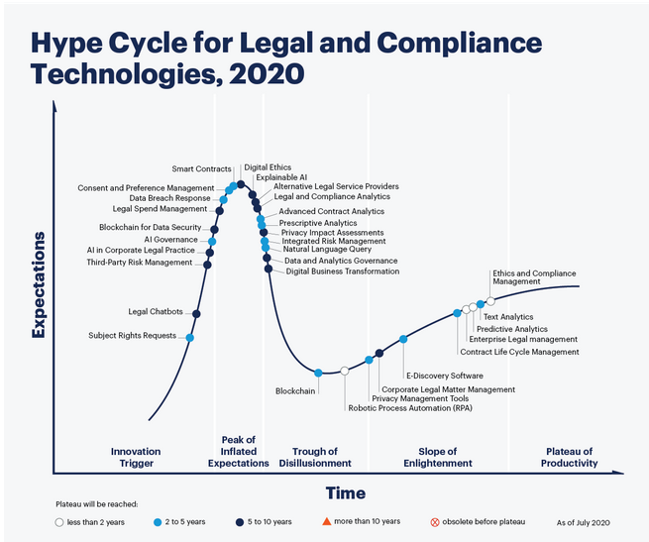
Gartner Hype Cycle for Legal/Compliance: 2020
CSCI3907/CSCI6444 - Big Data and Analytics
13-<number>

Slide 47
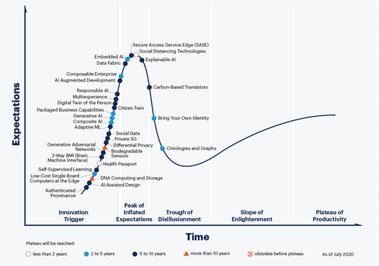
Gartner Hype Cycle for Emerging Technologies: 2020
https://www.gartner.com/en/newsroom/press-releases/2020-08-18-gartner-identifies-five-emerging-trends-that-will-drive-technology-innovation-for-the-next-decade
CSCI3907/CSCI6444 - Big Data and Analytics
13-<number>

